Slide 1
Extending Kubernetes API
API Server, custom API and custom resources

Slide 2

Objectives
Understand how to extend Kubernetes API
Application of extensions
Look at real some world examples of extensions

Slide 3
Overview
Part 1
Part 2
Intro into API Server (core API and structure), discovery
Extending the API Server with a custom API
Accessing the API Server via client libraries
Metrics server overview
Custom Resource Definitions (CRDs)
CRD controllers
Kubernetes operator library
Using Helm

Slide 4
API Server
Provides (mostly) REST API.
Exceptions: health checks.
Communicates with ETCD
API server gives access to the Kubernetes resources
and non-resource objects.

Slide 5
Kubernetes resources
Objects managed by Kubernetes:
pods, services, deployments
From Kubernetes docs:
”A resource is an endpoint in the Kubernetes API that stores
a collection of API objects of a certain kind; for example, the built-in pods resource contains a collection
of Pod objects”

Slide 6
Kubernetes non-resource objects
Metrics
Logs

Slide 7
Requests to API Server
kubectl get pods –v 6
kubectl proxy
Kubectl get --raw

Slide 8
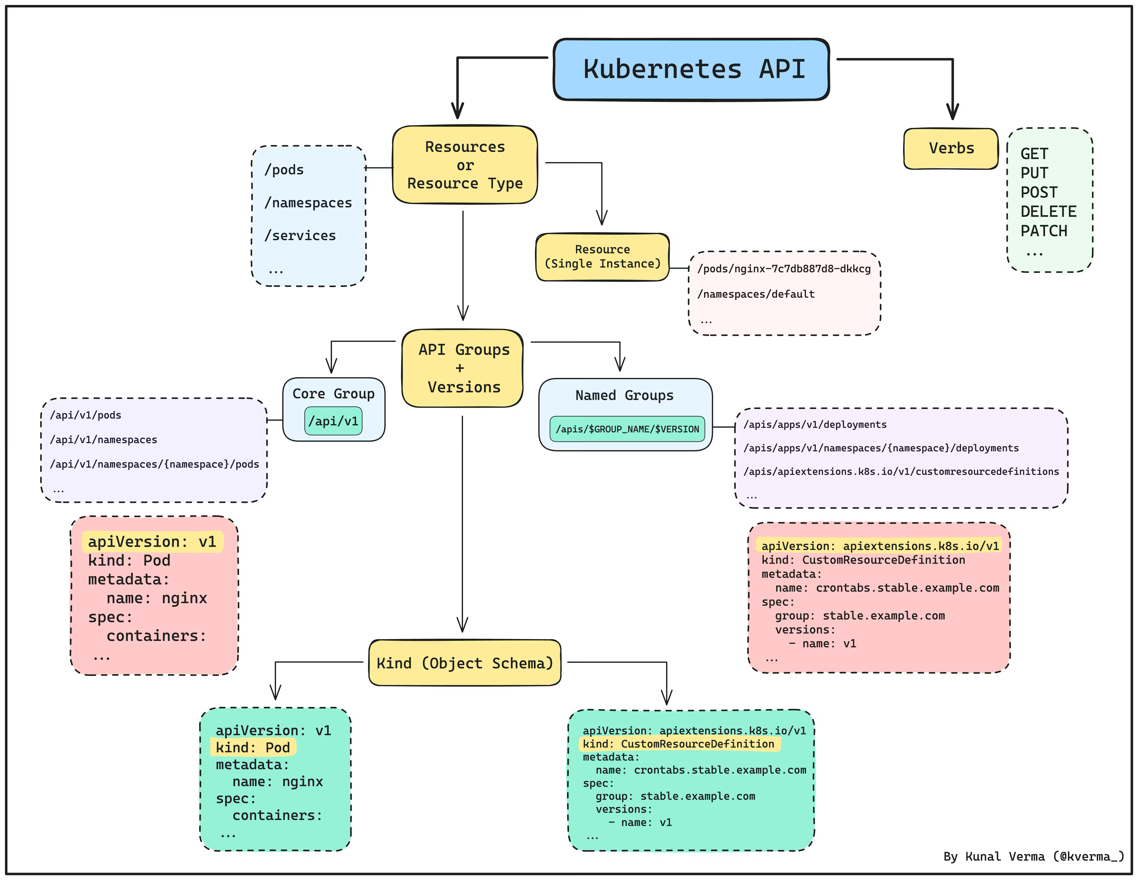
Kubernetes API structure

Slide 9
ApiService: use case
Metrics API implementation:
metrics API,
custom-metrics-apiserver

Slide 10
APIService
apiVersion: apiregistration.k8s.io/v1 kind: APIService metadata: name: v1alpha1.example.com spec: service: name: api-extension-server namespace: default group: example.com version: v1alpha1 insecureSkipTLSVerify: true groupPriorityMinimum: 1000 # Kubernetes uses this to resolve conflicts when multiple API groups serve the same resource. A higher value means higher priority. versionPriority: 15

Slide 11
Metrics server
kubectl create namespace metrics-server helm upgrade --install metrics-server metrics-server/metrics-server --set args="{--kubelet-insecure-tls}" -n metrics-server

Slide 12
Next steps
https://github.com/ybaryshnikova/extensions-meetup/tree/master/apiservice-example
Follow the metrics tutorial (link in references)

Slide 13
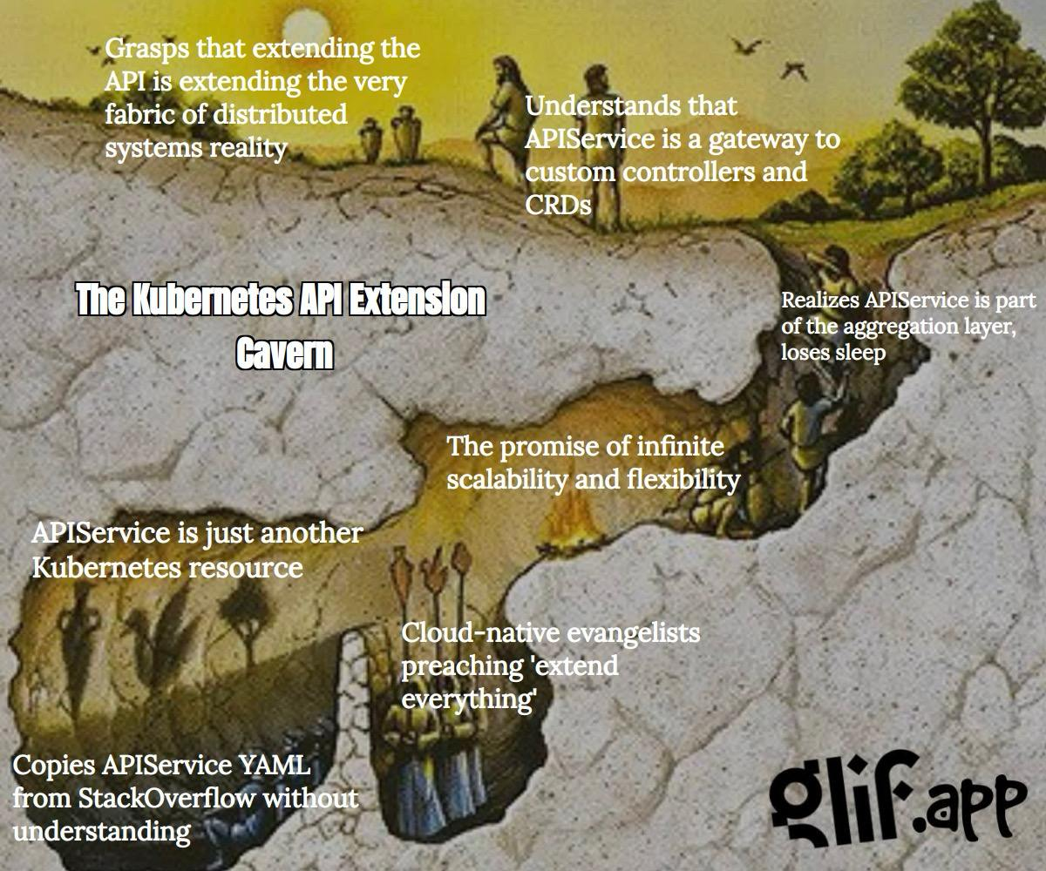
Fine art

Slide 14
References
Kubernetes API guide
Kubernetes Python client custom API Working with Kubernetes API Series Metrics server tutorial

Slide 15
Questions?

